Slide 1
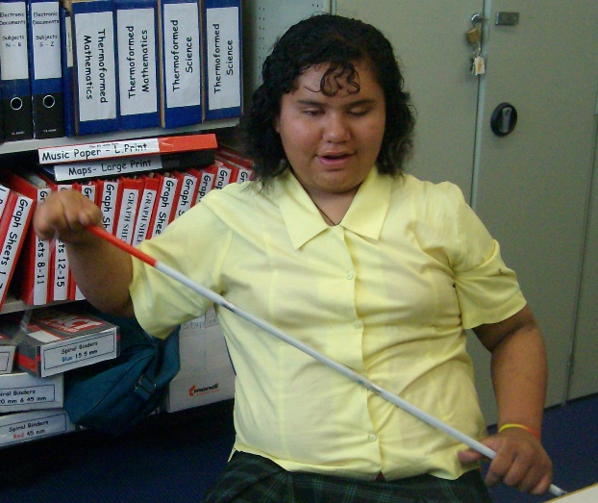
Fixing a WCIB Cane: Starring Freedom and Jesse!

Slide 2
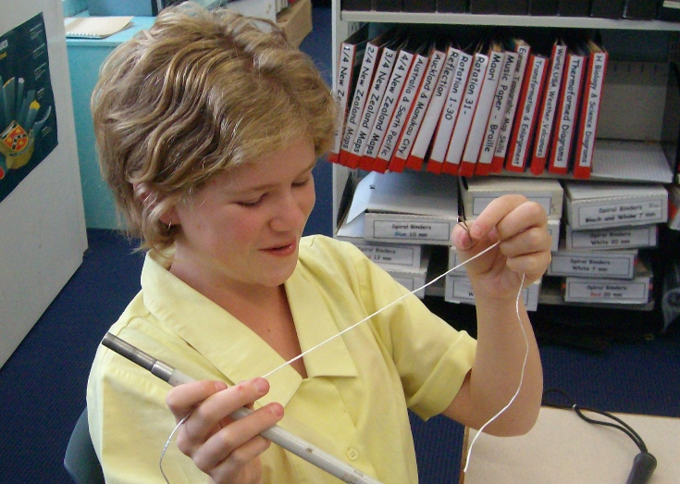
Sometimes a mobility cane snaps so what can you do?
Using your “technologically advanced cane
fixing kit” (a paper clip and string)
you can…
Fix it!

Slide 3
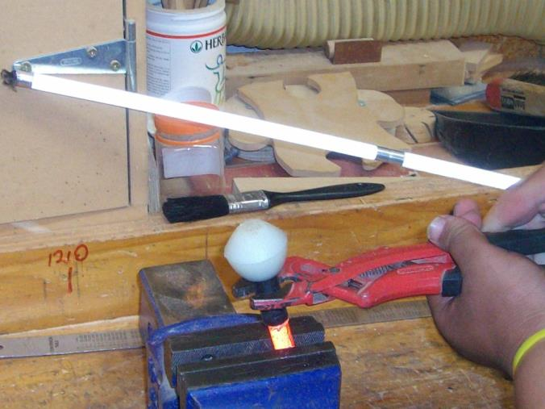
First get the tip off!
You might need a vice
But try warm water or
Pliers first

Slide 4
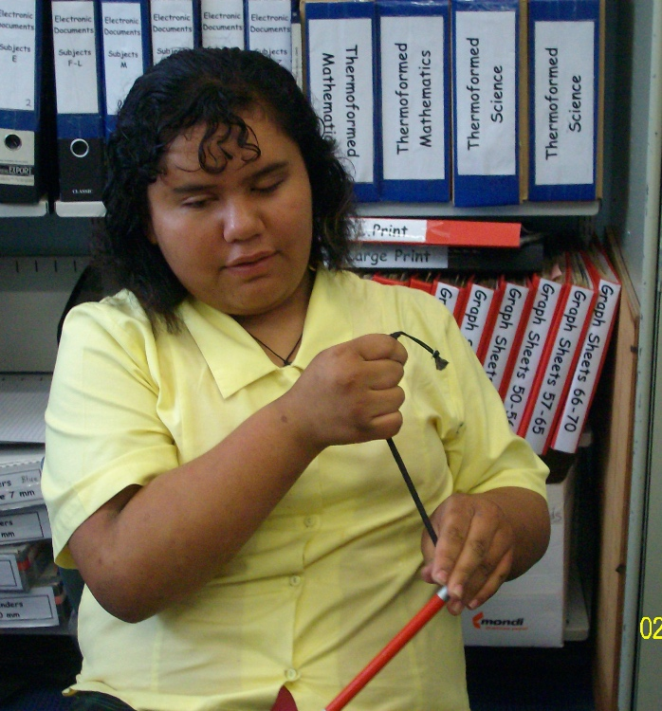
Then pull the string end and the elastic out of the ‘tip’ end of the cane

Slide 5
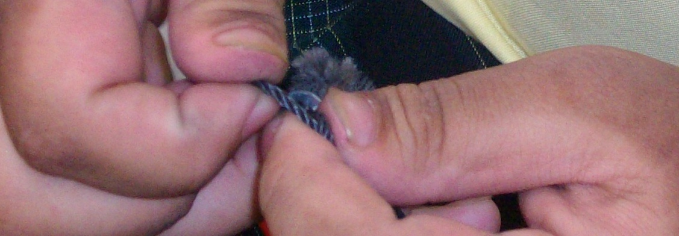
Then undo the string at the end of the elastic

Slide 6
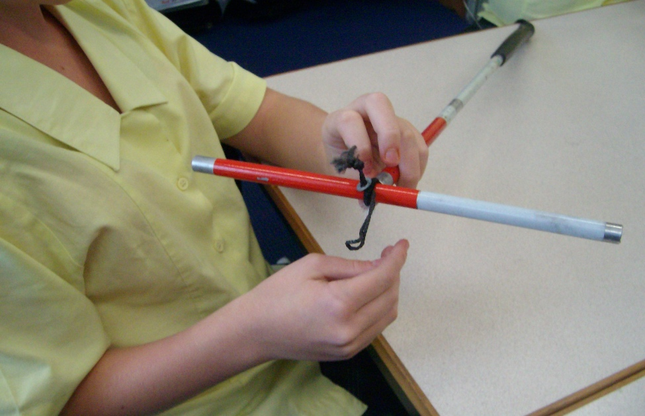
If need be jam something into the elastic loop to stop it ‘pinging’ into the cane parts

Slide 7
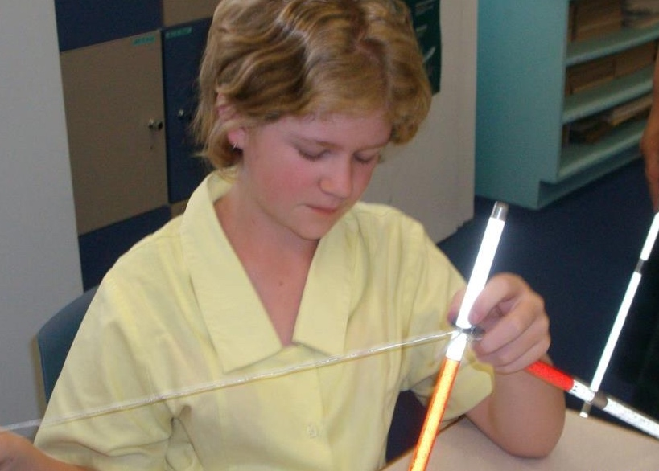
Then knot your string to the elastic, tie the opposite end to the paperclip or weight

Slide 8
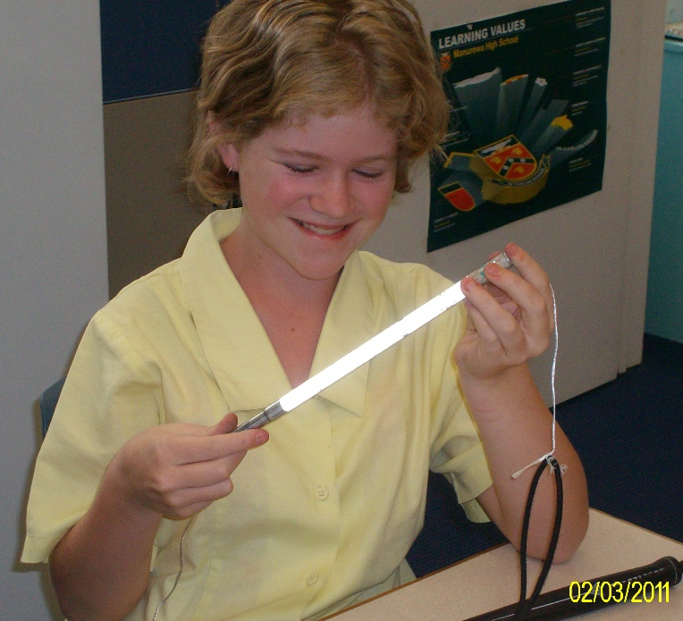
Pull the cane to pieces till you have the handle and string and a few bits!

Slide 9
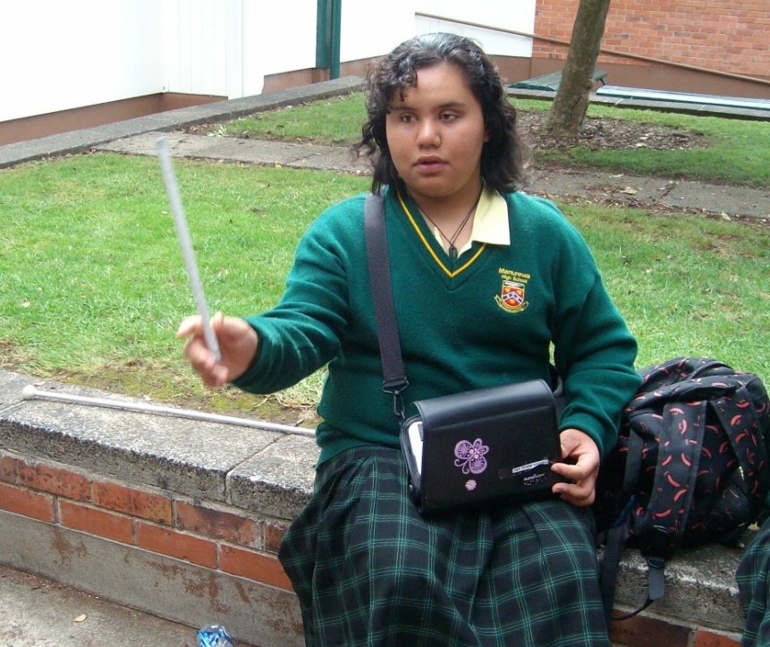
Remove the broken bit and find a new piece to replace it. You might need to use pliers, or something sharp, to remove bits inside the cane parts

Slide 10
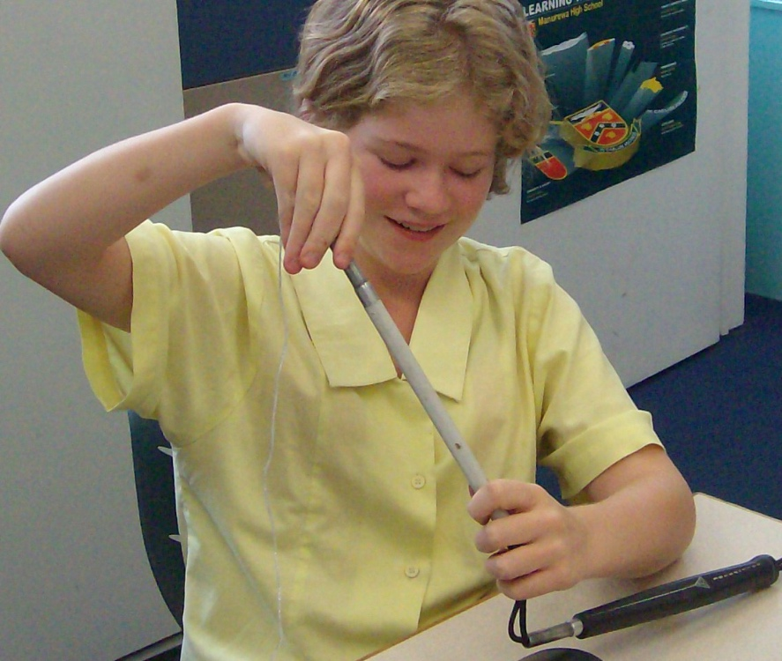
Rethread your cane by threading the paper clip end of the string attached to the elastic through each part
Be careful to place the pieces the correct way to ‘fit together’

Slide 11
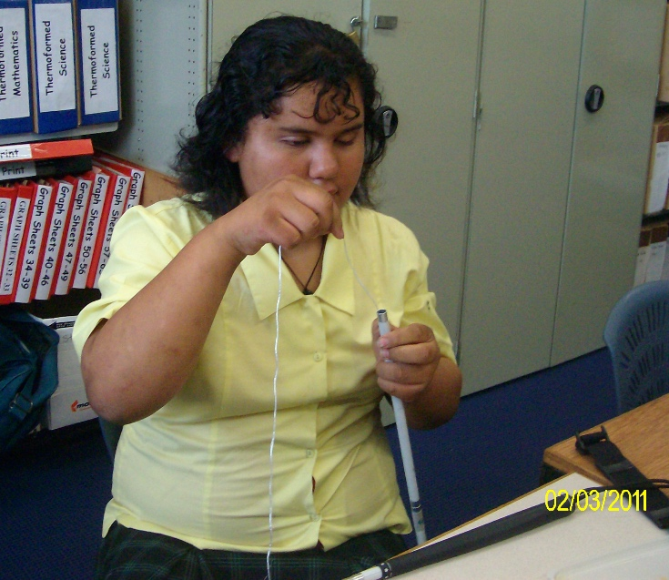
Or if you shortcut like Freedom: put all the pieces together and thread!

Slide 12
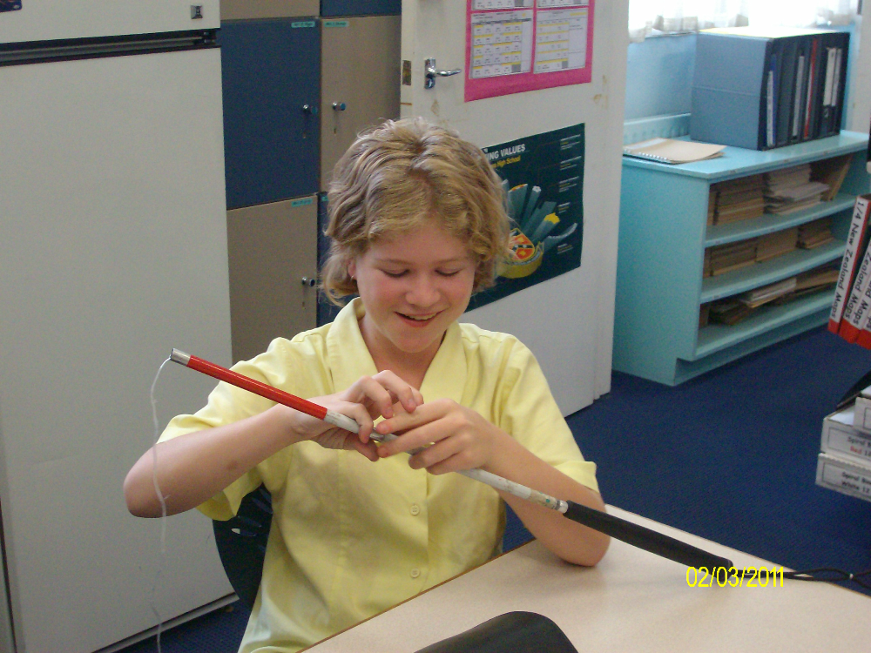
The last bit has two ‘short’ ends

Slide 13
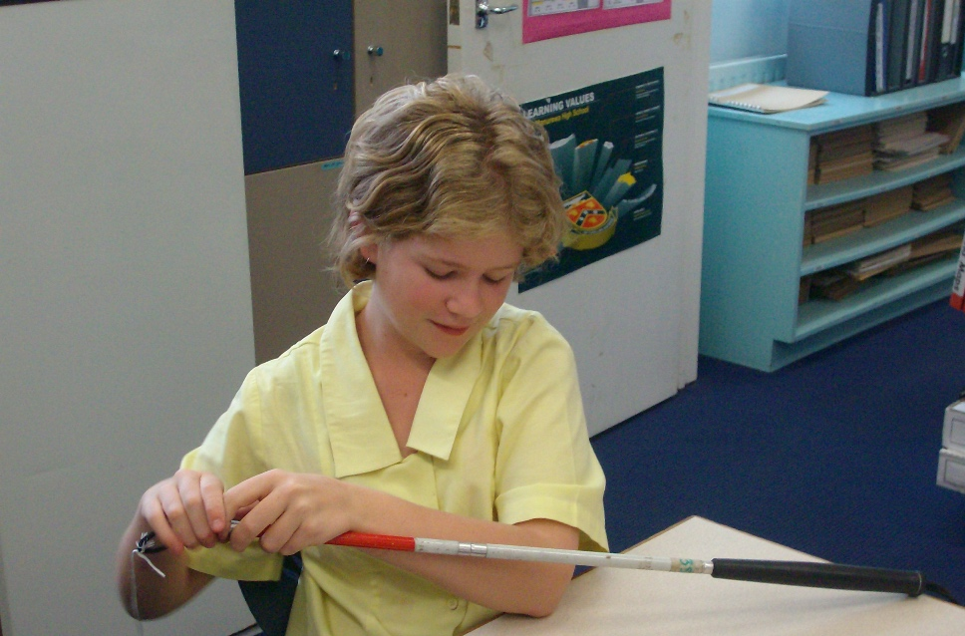
Pull the elastic through the last bit of the cane using the string

Slide 14
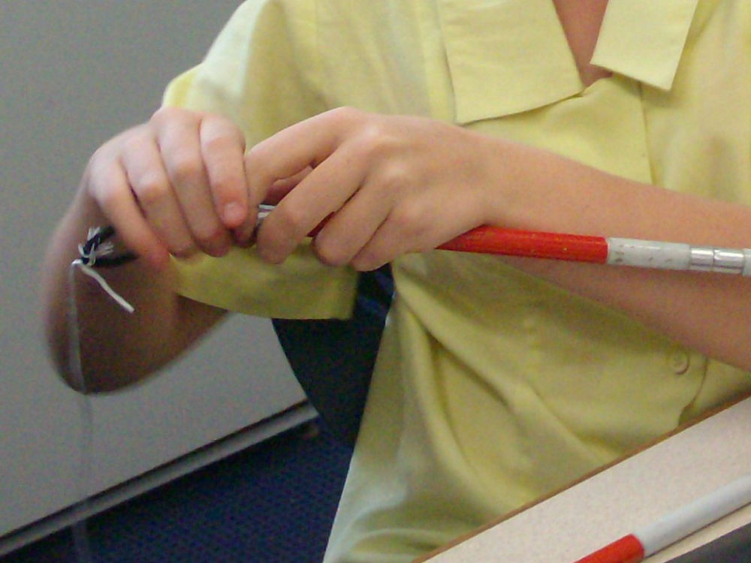
…rethread the little metal and string through the elastic, and cut your string

Slide 15
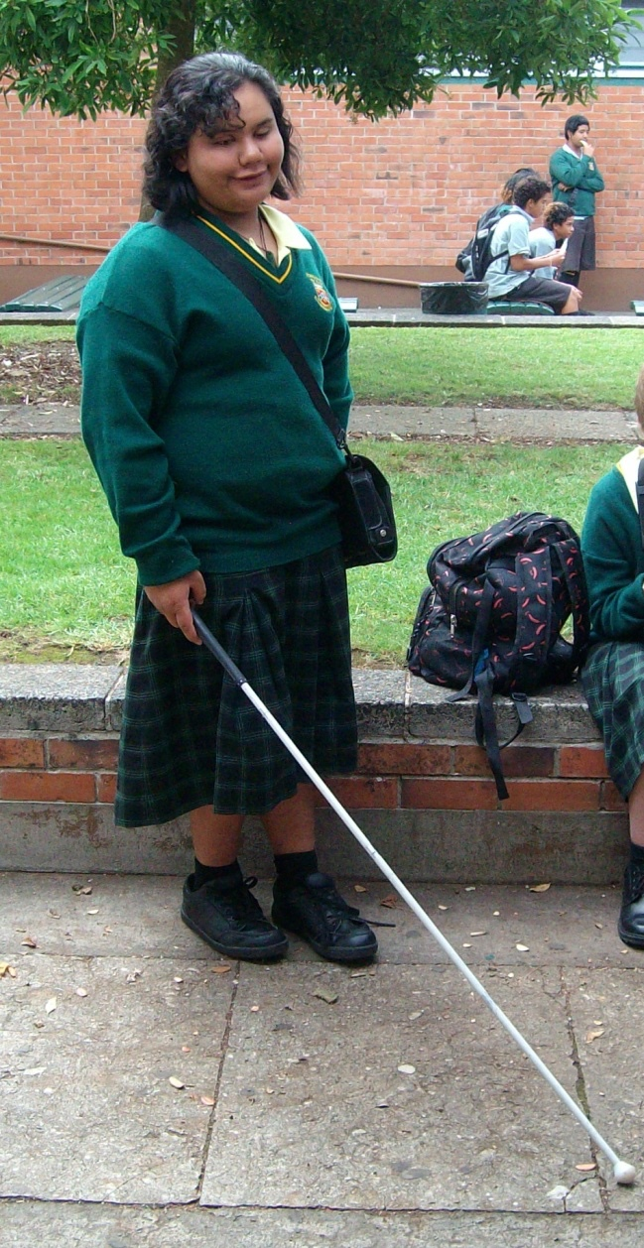
And you are done!
See your O&M if you need a new cane or
Check with your local Resource Teacher Vision for more information
Developed by Moving Forward Ltd and BLENNZ, 2014

