Slide 1
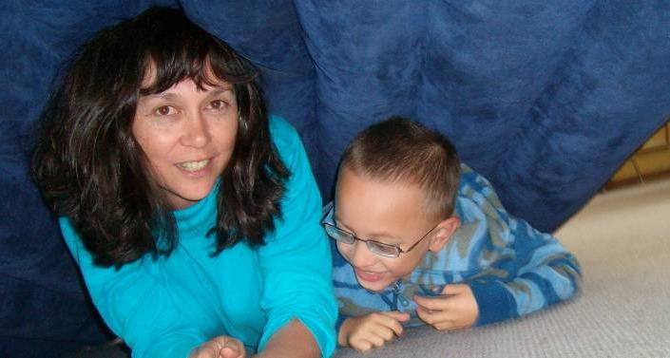
Motor Play and
Developmental Orientation & Mobility (DOM)
NB: All motor activity programmes need to be checked to ensure they are safe for the student

Slide 2
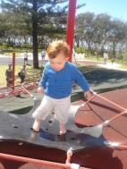
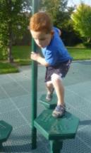
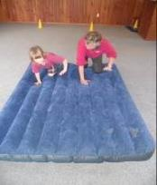
DOM is Moving with
Confidence & Purpose
Students with vision impairment have less motivation to move, in a scary world and therefore are at risk of problems with moving well later on
Good posture and gait later on is dependent on loads of early movement
Encouraging the child with vision impairment to want to move and play, actively, is extremely important!

Slide 3
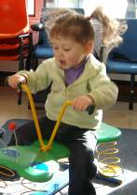
Motor Play Ideas
Rough and tumble, as much as possible, from
as early on as possible
Talk about the different movement and body
parts as you play!
Bounce on trampolines, rock, and swing
Crawl, climb and go through obstacle courses often
Have the child move for himself, actively ‘helping’ with daily/dressing tasks…give oodles of TIME to respond and engage
Encourage children to do as much for themselves as possible…. engaging their body and the world around them
Have fun!!!!

Slide 4
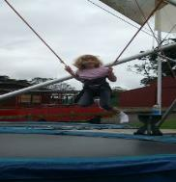
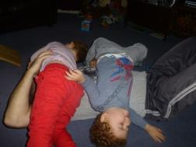
Motor Play Helps the Child:
Organise and develop the brain
Learn about the body and how to move it efficiently
Learn about space
Master the environment
And its fun!

Slide 5
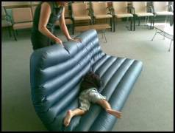
Guidance
Kids with Vision Impairment sometimes need to have a bit of guidance to want to move and have fun with motor play
So join in and have fun!
Talk and move and push
and roll together!

Slide 6
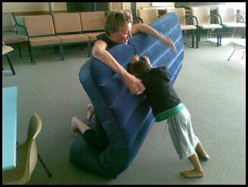
“Sensory” and “Motor” play have positive impacts on development of body image and motivation to move and engage.
It is especially important when there is a vision impairment!

Slide 7
Sensory and motor play
“Sensory” and “Motor” play have positive impacts on development of
body image and motivation to move
and engage.
It is especially important when there is a vision impairment!

Slide 8
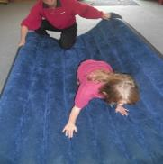
Sensory Motor Play is Important Because it:
Is interactive and you communicate heaps -visually, through speech, tactually- while playing
Helps you learn about HOW your body moves by actively moving it and labeling those moves
Provides fun opportunities to learn things like “beside”, “in front”, “behind”, “left”, “right” and so on
Primes the brain for learning!

Slide 9
Motor Play
Helps Develop Body Image
Body Image is...
knowledge of the body and its parts
knowledge of how to move with efficiency and ease… “doing without thinking”
developed by motor activity
crucial for relating the self to the environment
the foundation for learning about space and relationships of things in space
promoted by vision (it can be lacking if the child is vision impaired)

Slide 10
Poor Body Image Can Lead To:
Inability to move body parts efficiently
Lack of desire to move because it is too hard to think through
Difficulties with dealing with the environment because the child cannot relate to it because he hasn’t organised himself first
Lower fitness, strength, balance ability, than peers
Passivity, acting out, tactile ‘defensiveness’
(selectivity)

Slide 11
Poor Body Imagery can present as:
Being clumsy
Not wanting to or able to engage or follow tasks involving movement or seeing
Opting out of doing things normally fun for their age group
Unable to follow movement directions
Being lost in space

Slide 12
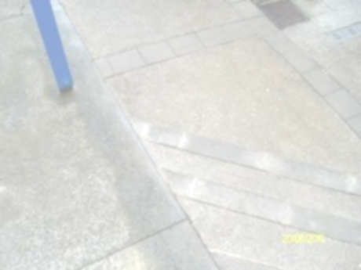
Movement
Not seeing well early on can lead to
risks in all movement areas because
the world is scary!
Would we want to move when steps look they do in figure 1?
So kids with Vision impairment often don’t learn about their bodies and space and master their worlds as easily as their peers.
Especially if they have other disabilities, like being in a wheelchair.
So movement is ESPECIALLY important for kids with vision impairment.

Slide 13
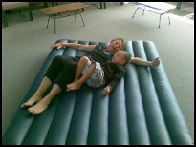
Motor play is a fun way to develop:
Body Image/Concepts
Strength, endurance fitness
Spatial awareness/Concepts
Control over self and environment
Ability to use Vision you have better
Interactive and communication skills
The ability to plan ahead
…these are all areas not seeing well can all impact on

Slide 14
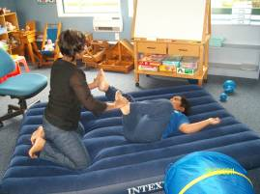
So what is the sensory part and why is it important?
We learn about our body and how it moves primarily via seeing it and feeling how it moves
When we can’t see it well we need to rely more on the ‘feeling it’ part
We FEEL how our body and
its parts move most precisely
and clearly when we move
it ourselves, with our body
weight on it - this is
through our
proprioceptive sense

Slide 15
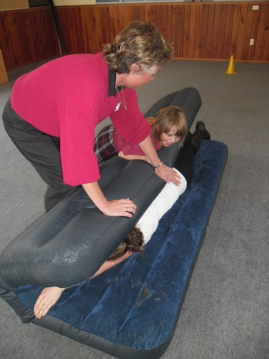
Proprioception is:
Developed by weight bearing or resistance play, such as crawling, climbing, push pull games
The firm pressure helps our brain to learn about our body and how to move it efficiently to get what we want and where we want, try waving your arm in the air and ‘feeling’ where it is. Then push down on it gently, the feeling of where it is, is clearer!

Slide 16
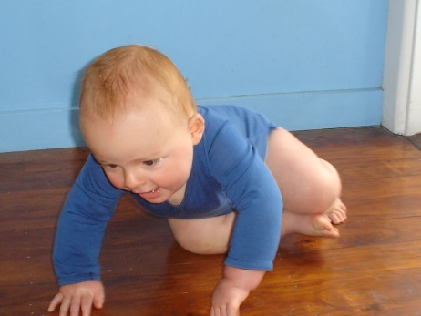
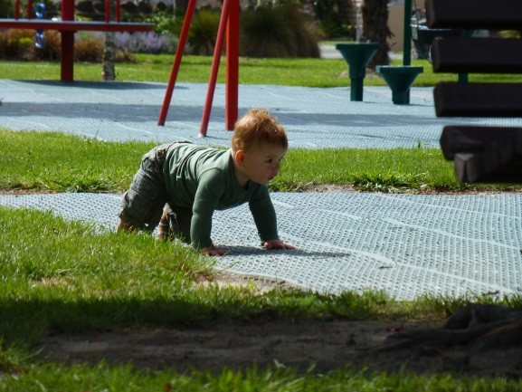
Think of a baby – he:
Learns about his arms and how to move them with greater control via:
First propping, or putting weight through the shoulder and arms and hands over and over again. His brain is learning how to use his muscles and arms to push up, he then learns how to crawl by repeatedly weight bearing through his arms and legs, teaching his brain how to move these bits in increasingly efficient ways to get to the position and place he wants to get to!
This weight bearing sends great messages to the brain about how to move better and better!

Slide 17
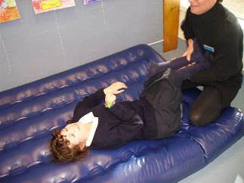
We can use this Proprioceptive sense to help the kids with vision impairment learn their body Image!
They can learn about how their body moves, even when they can’t move much themselves - by this firm sense of pressure:
NB: always check with the team involved with the student before commencing any motor programming

Slide 18
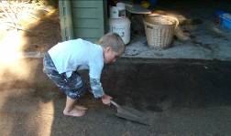
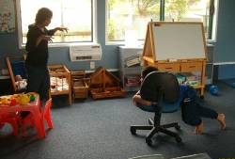
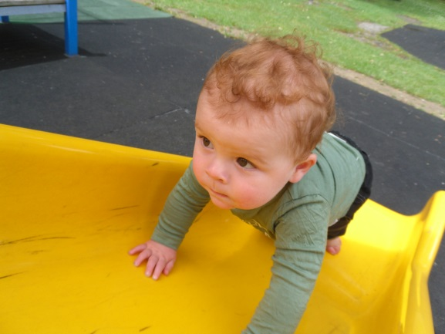
More Proprioception Play Ideas
Pushing yourself on an office chair
Playing in a tunnel or blanket wrapping
Playing push n shove game
Playing animals in a zoo
Doing tasks at home

Slide 19
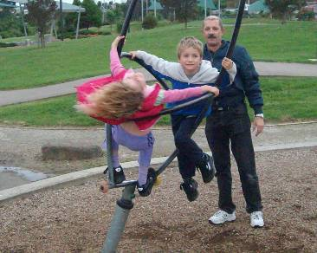
The sensory part also includes the VESTIBULAR sense
This is the sensory input that kids get from:
Swinging
Rocking
Hanging upside down
Spinning and going
round and round

Slide 20
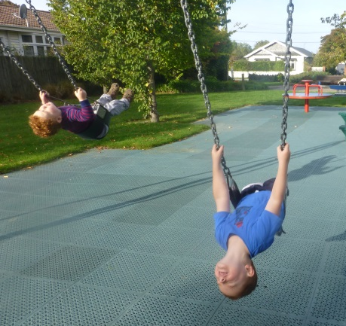
The vestibular sense helps to:
Develop motor skills and control-including reflex integration
Develop balance
Increase arousal and attention / focus
Promote exploring of the environment
Control head & eye movements
Develop use of vision (fixation, movement)
Define the ability to turn
Promote language & emotional development
Increase spatial awareness
Increase attention to a task (ie stimulates, calms & sets brain up for attention)
And MORE!!!!
(Sources include: Schiffman, 1982; Daly & Moore, 1997)

Slide 21
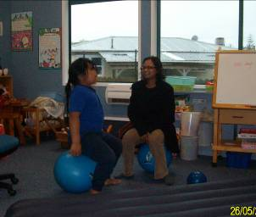
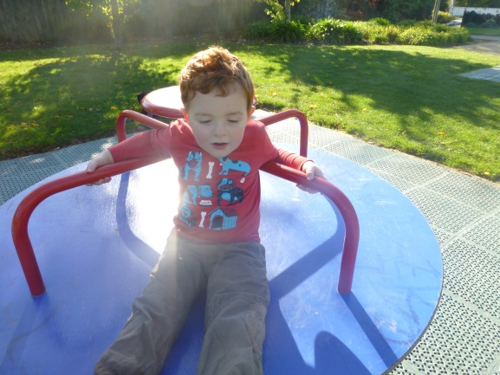
Vestibular Play Ideas
Rolling down hills
Spinning on an office chair
Rough n tumble
Rocking and bouncing
Simon says
Anything that has the
head position changing!

Slide 22
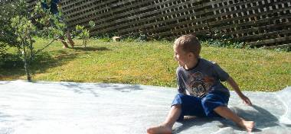
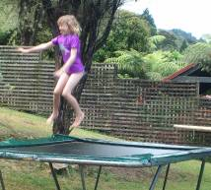
Motor Play…we all need it!
Kids love it and it’s important for ALL children - especially for those with sensory issues (especially vision impairment!)
Kids are RIGHT! Rough and tumble, running around and climbing are not just fun they are developmentally NEEDED!

Slide 23
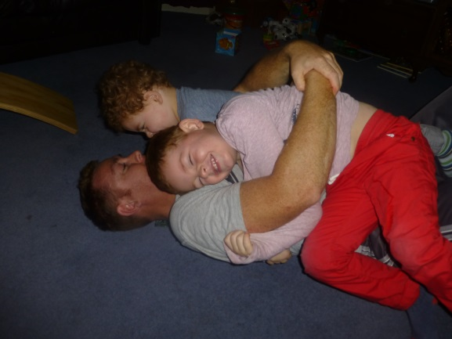
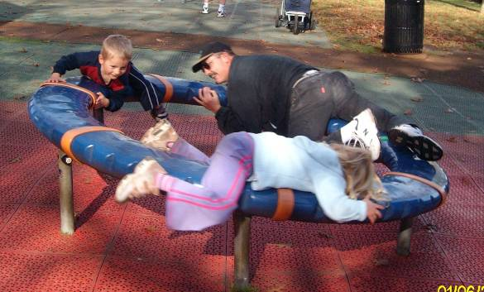
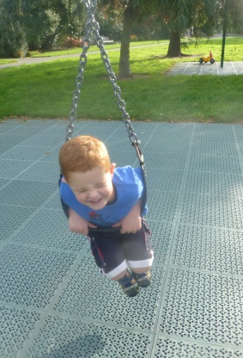
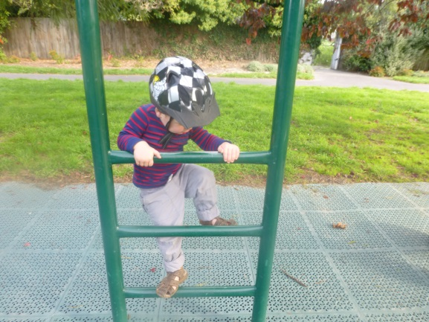
So ENJOY
Check with your local Resource Teacher: Vision for more information
Developed by Moving Forward Ltd and BLENNZ, 2014

Slide 24
Links
Get Ready for School Website
Moving Smart Website

